Slide 1
Service-oriented architecture
Manuel Molina 2016-5468

Slide 2
What is Service oriented Architecture?
Service-oriented architecture (SOA) is a way of organizing software through the use of what are called “services”.
These “services” communicate with each other. The communication can involve either simple data passing or it could involve two or more services coordinating some activity.

Slide 3

Services
Services are units of logic that are normally run on a network.
In other words a service is a function that is well-defined, self-contained, and does not depend on the context or state of other services.
Notes:
The request and subsequent response connections are defined in some way that is understandable to both the service consumer and service provider.

Slide 4
Properties of a service
It logically represents a business activity with a specified outcome.
It is self-contained.
It is a black box for its consumers.
It may consist of other underlying services.

Slide 5
Service Functionality
It handles a business process such as calculating an insurance quote or distributing email; handles a technical task such as accessing a database; or provides business data and the technical details to construct a graphical interface.
It can access another service. With the appropriate runtime technology, it can access a traditional program and respond to different kinds of requesters, such as web applications.
It is relatively independent of other software. Changes to a requester require few or no changes to the service. Changes to the internal logic of a service require few or no changes to the requester. The relative independence of the service and other software is called loose coupling.
Notes:
It handles a business process such as calculating an insurance quote or distributing email; handles a technical task such as accessing a database; or provides business data and the technical details to construct a graphical interface.
It can access another service. With the appropriate runtime technology, it can access a traditional program and respond to different kinds of requesters, such as web applications.
It is relatively independent of other software. Changes to a requester require few or no changes to the service. Changes to the internal logic of a service require few or no changes to the requester. The relative independence of the service and other software is called loose coupling.

Slide 6
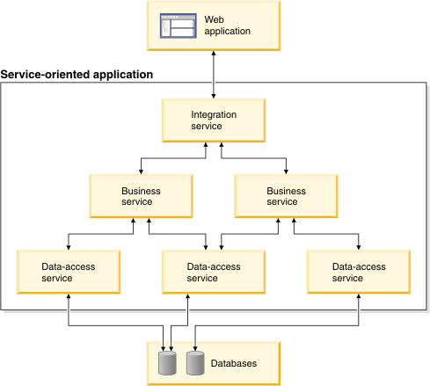
Service-Oriented Applications
A service-oriented application is an application that is composed largely of services, which are often in a hierarchy.
Notes:
The topmost level contains one or more integration services, each of which controls a flow of activities, such as processing an applicant's request for insurance coverage. Each integration service invokes one or more business services.
The second level is composed of services that each fulfill a relatively low-level business task. For example, an integration service might invoke a series of business services to verify the details that were provided by an insurance-policy agent. If the business services return values that are judged to mean "issue a policy," the integration service invokes another business service. The second business service calculates a quote and returns the quote to the software, such as a web application, that invoked the service-oriented application.
The third level consists of data-access services, each of which handles the relatively technical task of reading from and writing to data-storage areas, such as databases and message queues.

Slide 7
The importance of Service-Oriented Architecture

Slide 8
Creates reusable code
By reusing code that already exists within a service, enterprises can significantly reduce the time that is spent during the development process. Not only does the ability to reuse services decrease time constraints, but it also lowers costs that are often incurred during the development of applications.

Slide 9
Promotes interaction
A major advantage in using SOA is the level of interoperability that can be achieved when properly implemented. With SOA, no longer will communication between platforms be hindered in operation by the languages on which they are built. Once a standardized communication protocol has been put in place, the platform systems and the varying languages can remain independent of each other, while still being able to transmit data between clients and services.

Slide 10
Allows for scalability
By using an SOA where there is a standard communication protocol in place, enterprises can drastically reduce the level of interaction that is required between clients and services, and this reduction means that applications can be scaled without putting added pressure on the application

Slide 11
Reduced costs
By switching to an SOA-based system, businesses can limit the level of analysis that is often required when developing customized solutions for specific applications. This cost reduction is facilitated by the fact that loosely coupled systems are easier to maintain and do not necessitate the need for costly development and analysis.

Slide 12
Summary
Service-oriented architecture is a way of organizing software through the use of services.
Services are units of logic that are normally run on a network that are usually self contained and independent from each other.
Services are divided into a hierarchy each one with an assigned role.
Service-oriented architecture has many benefits such as the creation of reusable code, easier scalability and cost reduction.

